Slide 1
A Seminar on Enhanced security for Cloud-Based keyword search on Encrypted Data
Team Details
D Vipul Avinash (20EG105311)
R Divakar Reddy (20EG105344)
M Srivalli (20EG105702)
Project Supervisor
Dr. J Balaraju
M.Tech., Ph.D
Assistant Professor
26/03/2024
Department of Computer Science and Engineering

Slide 2
Introduction
What is cloud computing?
Cloud computing is the use of computing resources (hardware and software) that are delivered as a service over a network (typically the Internet). The name comes from the common use of a cloud-shaped symbol as an abstraction for the complex infrastructure it contains in system diagrams. Cloud computing entrusts remote services with a user's data, software and computation. Cloud computing consists of hardware and software resources made available on the Internet as managed third-party services. These services typically provide access to advanced software applications and high-end networks of server computers.
How Cloud Computing Works?
The goal of cloud computing is to apply traditional supercomputing, or high-performance computing power, normally used by military and research facilities, to perform tens of trillions of computations per second, in consumer-oriented applications such as financial portfolios, to deliver personalized information, to provide data storage or to power large, immersive computer games.The cloud computing uses networks of large groups of servers typically running low-cost consumer PC technology with specialized connections to spread data-processing chores across them. This shared IT infrastructure contains large pools of systems that are linked together. Often, virtualisation techniques are used to maximize the power of cloud computing.
26/03/2024
Department of Computer Science and Engineering

Slide 3
Introduction
With the increasing popularity of cloud computing, data owners are often required to outsource their data to cloud servers for storage and processing. However, the security of outsourced data is a major concern due to the possibility of unauthorized access by cloud providers or malicious attackers. To address this problem, the proposed system introduced a novel expressive authorized keyword search scheme relying on the concept of ciphertext-policy attribute-based encryption.
26/03/2024
Department of Computer Science and Engineering

Slide 4
Problem Statement
In the landscape of cloud computing, the increasing practice of outsourcing data to cloud servers in encrypted form raises the challenge of efficiently conducting authorized keyword searches without compromising data privacy.
Existing System:
Li et al. proposed an PKAKS scheme using the concept of Hierarchical Predicate Encryption for multi-owner and multi-user setting, where only authorized users can perform keyword search over the encrypted indexes. However, it incurs high communication overhead, as a user needs to contact the attribute authority to generate trapdoors for each search request. Also, the scheme is suitable to perform keyword search over structured database which contains limited keywords
Disadvantages:
The existing system scheme incurs high communication overhead as each search request requires the user to contact the attribute authority to generate trapdoors, which can be time-consuming and expensive
26/03/2024
Department of Computer Science and Engineering

Slide 5
Problem Illustration
In a cloud environment, data owners want to outsource their encrypted data to cloud servers for better data availability and accessibility while ensuring data secrecy. However, they also want to be able to perform keyword searches over the encrypted content without disclosing any information unintended entities. This creates a challenge as traditional search methods would require decryption of the data, which would defeat the purpose of encryption.
Suppose a hospital wants to store patient records in an encrypted form on a cloud server. The hospital wants the records to be searchable by authorized doctors and medical staff based on certain keywords, such as the patient's name, medical condition, or medication. However, the hospital does not want to disclose any information about the patient's records to unintended entities, such as unauthorized doctors, medical staff, or hackers. The hospital needs a secure and efficient way to perform keyword searches over the encrypted data while ensuring data confidentiality.
26/03/2024
Department of Computer Science and Engineering

Slide 6
Proposed Method
The proposed system uses an expressive fine-grained authorized keyword search scheme for designing for multi-owner and multiuser scenarios using the concept of Ciphertext-Policy Attribute-Based Encryption (CP-ABE).
In the proposed system the Owner module allows the data owner to upload encrypted files to the cloud server and view their file details and encrypted index. The User module enables authorized users to search for encrypted data based on their granted privileges, with a request sent to the cloud server for verification by the Verification Authority. The Attribute Authority is responsible for approving new user registrations, and the Verification Authority verifies search access rights of users. The CSP stores and retrieves encrypted data and performs keyword search based on valid search access rights
26/03/2024
Department of Computer Science and Engineering

Slide 7
Proposed Method Illustration
Data Owner: Alice and Bob are data owners who have encrypted their files using CP-ABE and uploaded them to the Cloud Service Provider (CSP).
They can view their file details and encrypted index on the Owner Module interface.
Users: Charlie and Daisy are authorized users who have been granted privileges to search for encrypted data. They can search for encrypted data based on their granted privileges using the User Module interface. A request is sent to the Verification Authority for verification.
Verification Authority: The Verification Authority verifies search access rights of users, such as Charlie and Daisy, before granting them access to the encrypted data.
Attribute Authority: The Attribute Authority is responsible for approving new user registrations, such as Charlie and Daisy.
Cloud Service Provider (CSP): The CSP stores and retrieves encrypted data and performs keyword search based on valid search access rights
26/03/2024
Department of Computer Science and Engineering

Slide 8
Proposed Method Illustration (Example)
Alice has a file containing sensitive information that she wants to share with Bob and Charlie, but not with Daisy. She encrypts the file using CP-ABE, specifying an access policy that grants Charlie access to the file. Alice uploads the encrypted file to the CSP and can view its details and encrypted index on the Owner Module interface.
Charlie wants to search for the encrypted file on the CSP. He uses the User Module interface to send a request to the Verification Authority, which verifies his privileges and grants him access to the file. Daisy, who does not have the necessary privileges, is unable to access the file.
In this example, the system uses an expressive fine-grained authorized keyword search scheme with CP-ABE for multi-owner and multiuser scenarios, ensuring secure and efficient sharing of encrypted data while protecting data privacy and access control.
26/03/2024
Department of Computer Science and Engineering

Slide 9
Experiment
Environment
Hardware Requirements
System : Intel Core i5 Processor
RAM : 32GB
Hard Disk : 1 TB HDD
Input Devices : Keyboard, Mouse
Software Requirements
Operating system : Windows 10.
Coding Language : JAVA.
Tool : Netbeans 8.2
Database : MYSQL
26/03/2024
Department of Computer Science and Engineering

Slide 10
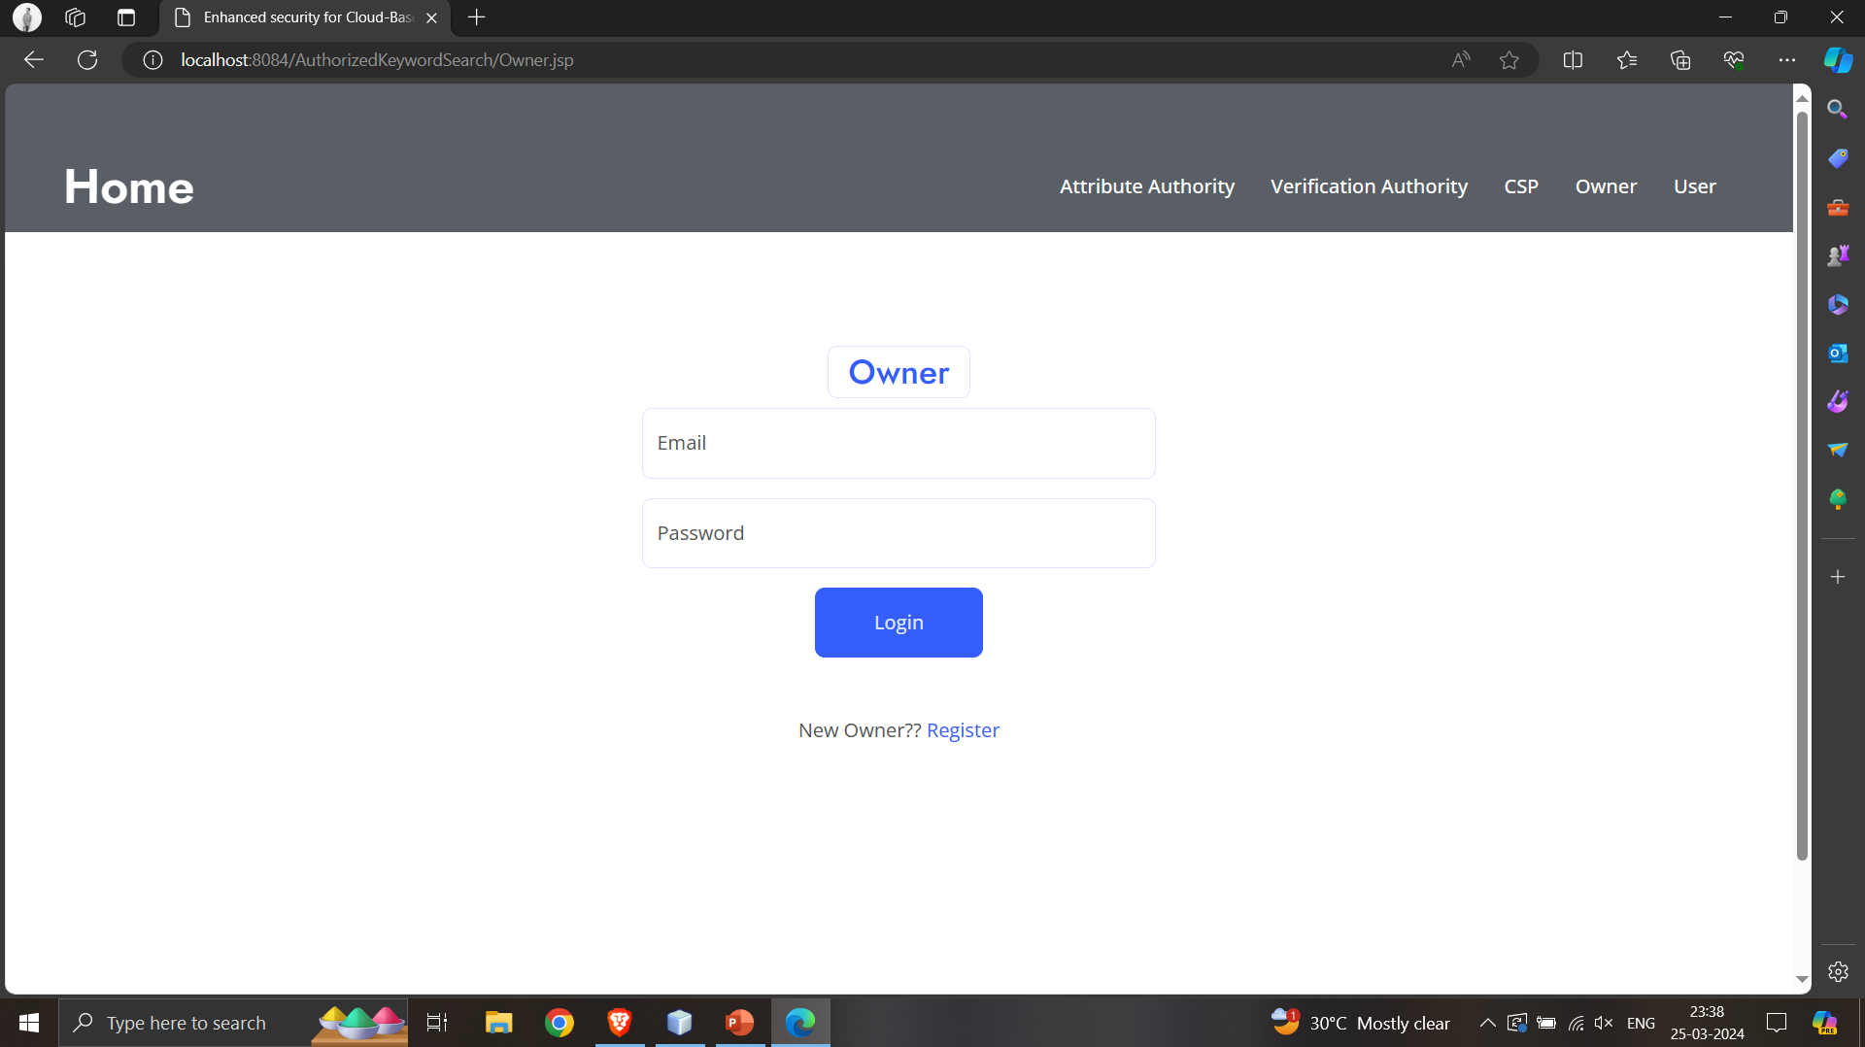
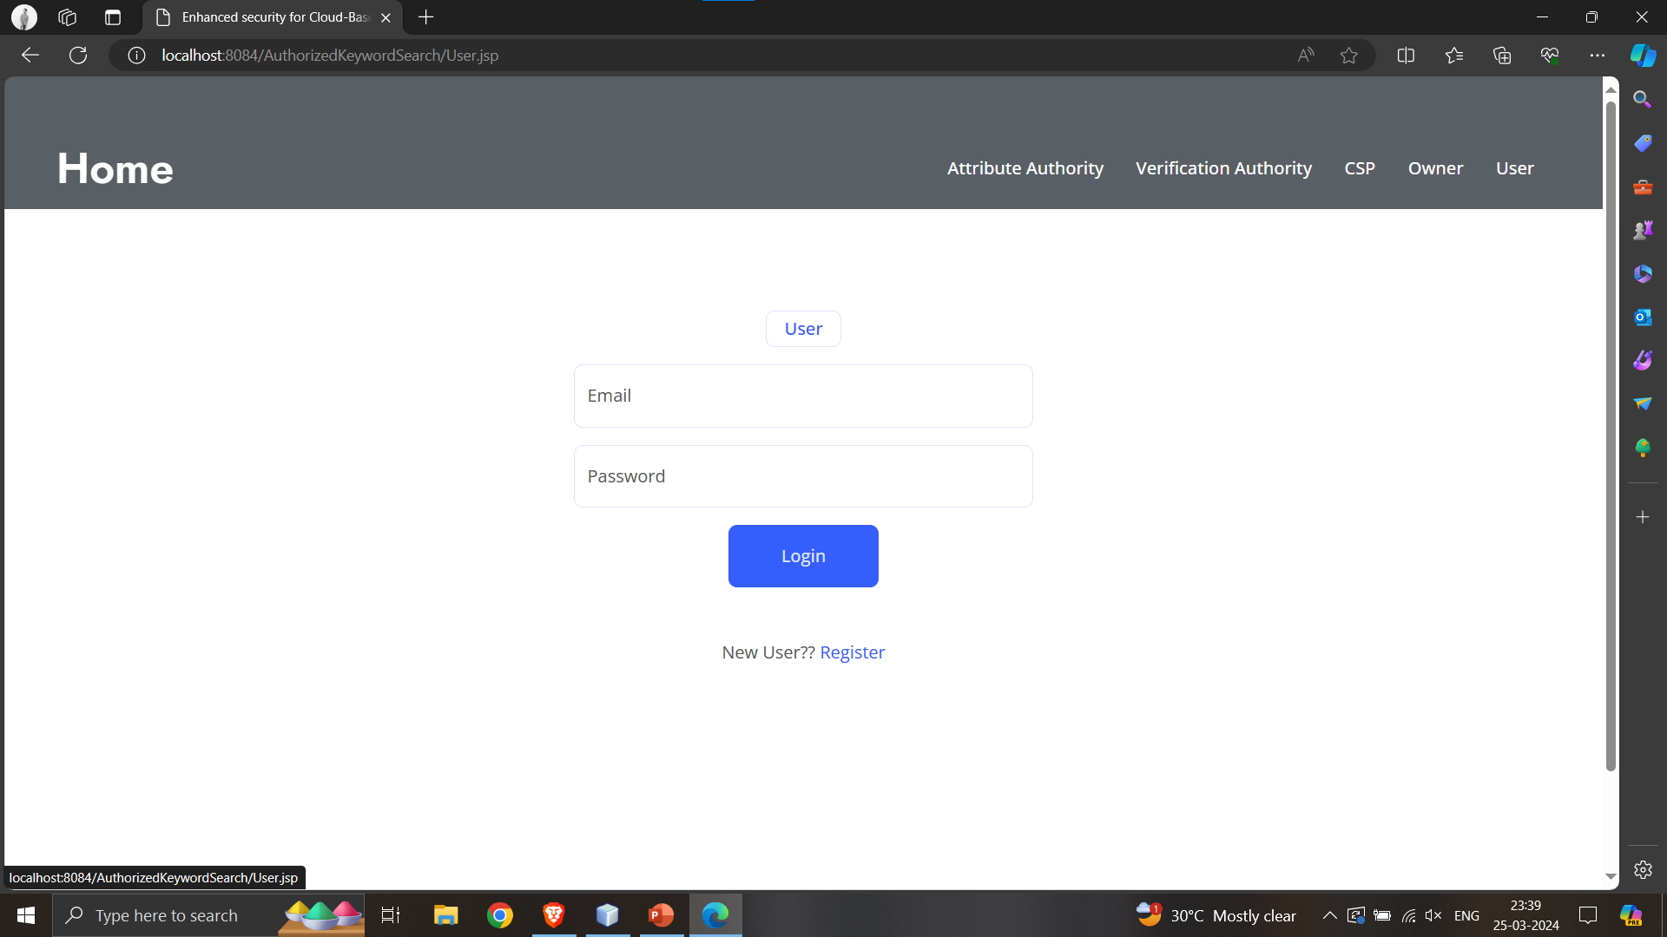
Experiment
Screenshots
26/03/2024
Department of Computer Science and Engineering

Slide 11
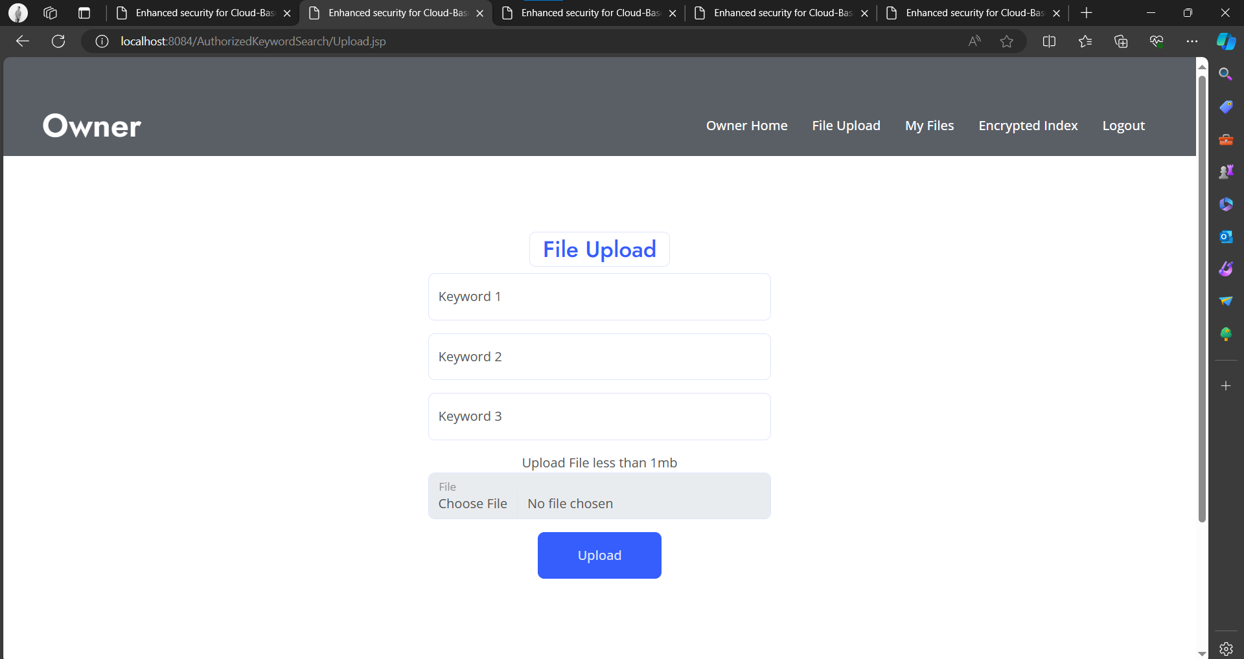
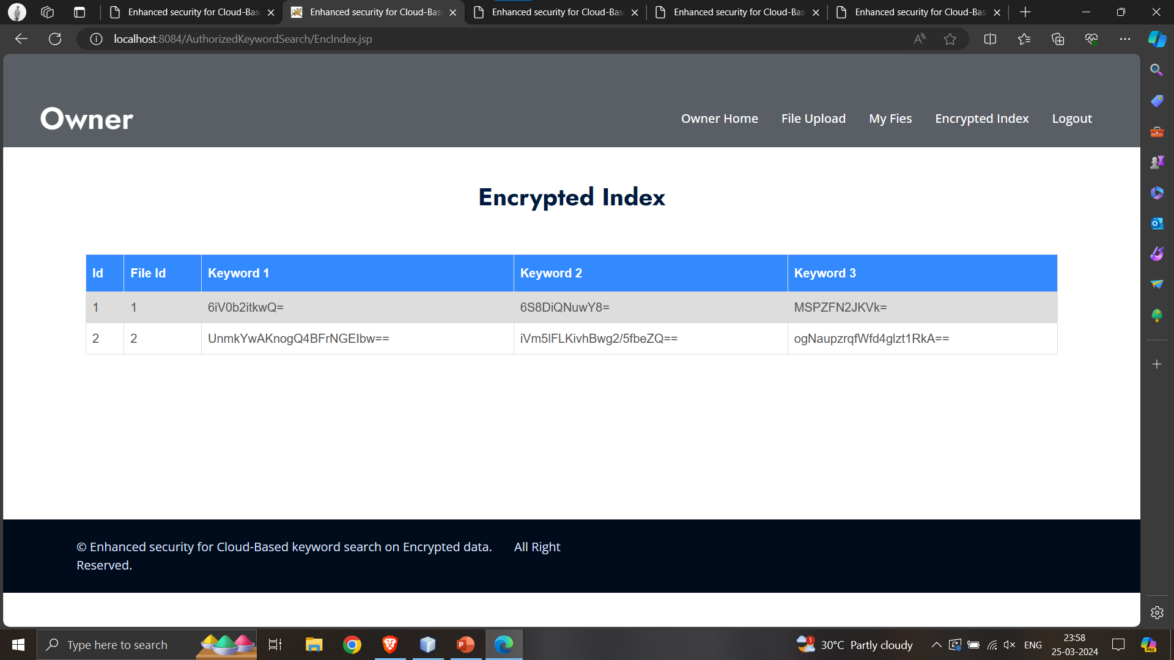
Experiment Results
26/03/2024
Department of Computer Science and Engineering

Slide 12
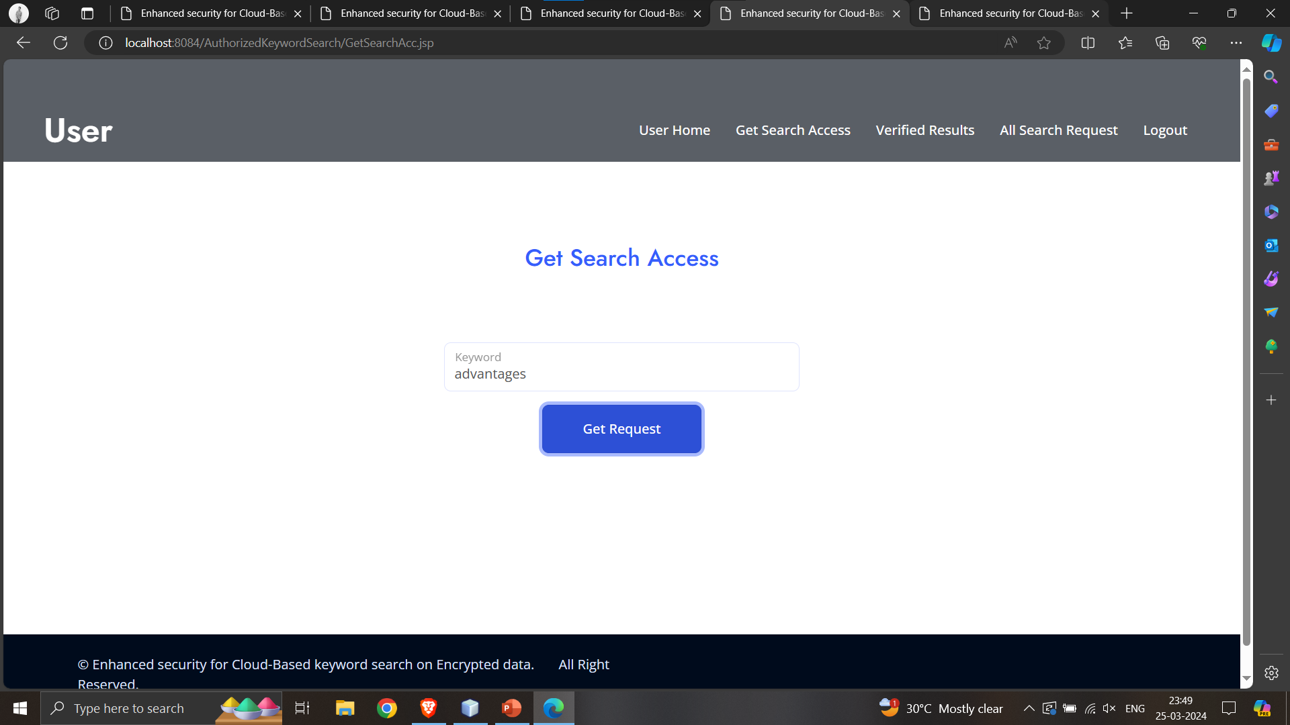
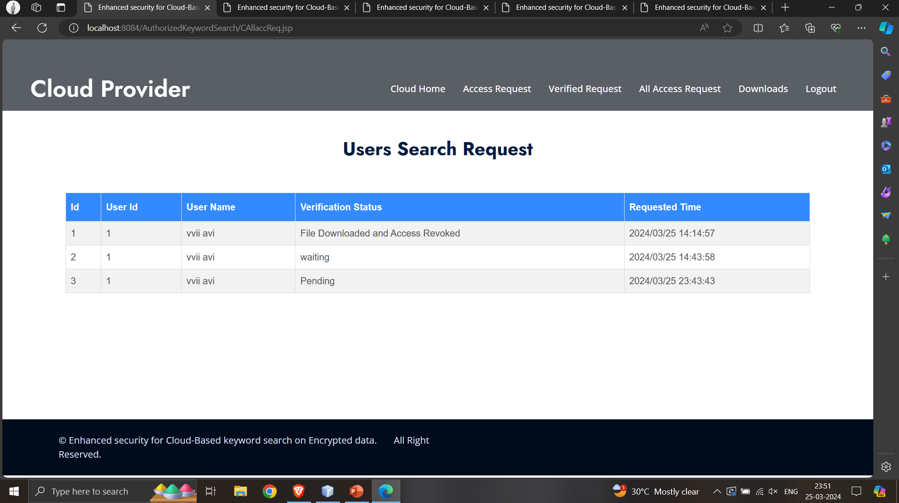
Experiment Results
26/03/2024
Department of Computer Science and Engineering

Slide 13
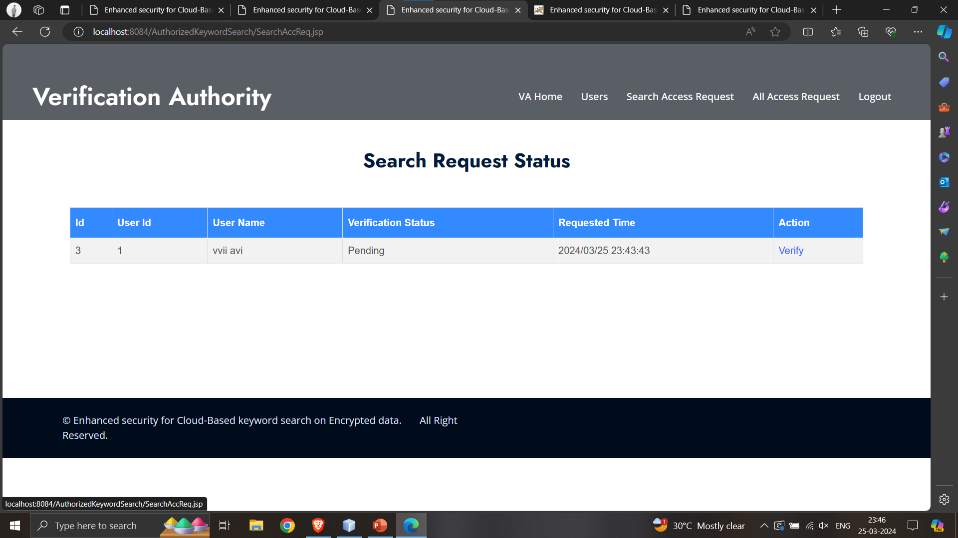
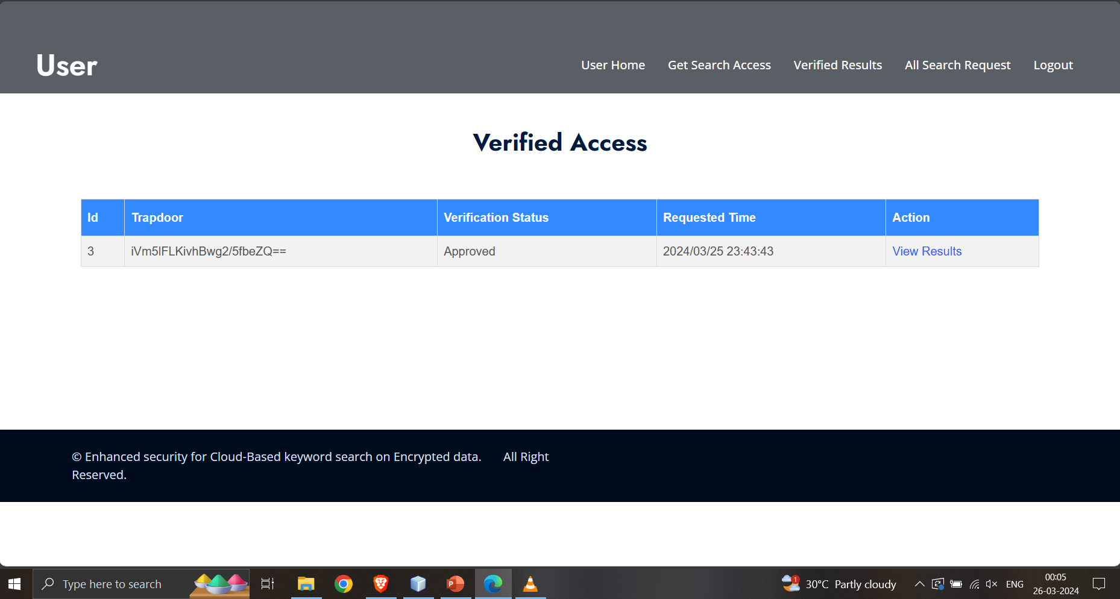
Experiment Results
26/03/2024
Department of Computer Science and Engineering

Slide 14
Findings
In this paper, a fine-grained authorized expressive keyword search scheme has been proposed. The proposed scheme uses the benefits of CP-ABE to perform efficient keyword search over encrypted data and for authorizing users. The security analysis is performed under standard complexity assumptions and it shows that the proposed scheme is semantically secure against the chosen keyword attack. The scheme is also resistant against keyword guessing attacks. Moreover, the performance analysis of the proposed scheme shows that it outperforms the closely-related works in terms of storage, communication overhead, and computational overhead. Security, efficiency, and query expressiveness are the three main factors that define the practical usability of a keyword search scheme. A user expects that the keyword search scheme provides strong security and high efficiency (in terms of computation and communication costs), as high as for normal plaintext search.
26/03/2024
Department of Computer Science and Engineering

Slide 15
Justification
Parameters:
In this proposed scheme Enhanced security for Cloud-Based keyword search on Encrypted Data we have 5 entities: Verification Authority(VA), Attribute Authority(AA), Cloud Service Provider(CSP), Owner and User.
Encryption: Encrypt (PK, ck, A) → CT
Secret Key Generation: KeyGen (S, PK, MK) → SK
Decryption: Decrypt (CT, PK, SK) → ck
26/03/2024
Department of Computer Science and Engineering

Slide 16
Thank you
26/03/2024
Department of Computer Science and Engineering

